Slide 1
Python Identifiers
Rules for writing identifiers:
Use only alphanumeric characters and underscores.
Never start with a number
Use underscores to separate two words
Keywords cannot be identifiers

Slide 2
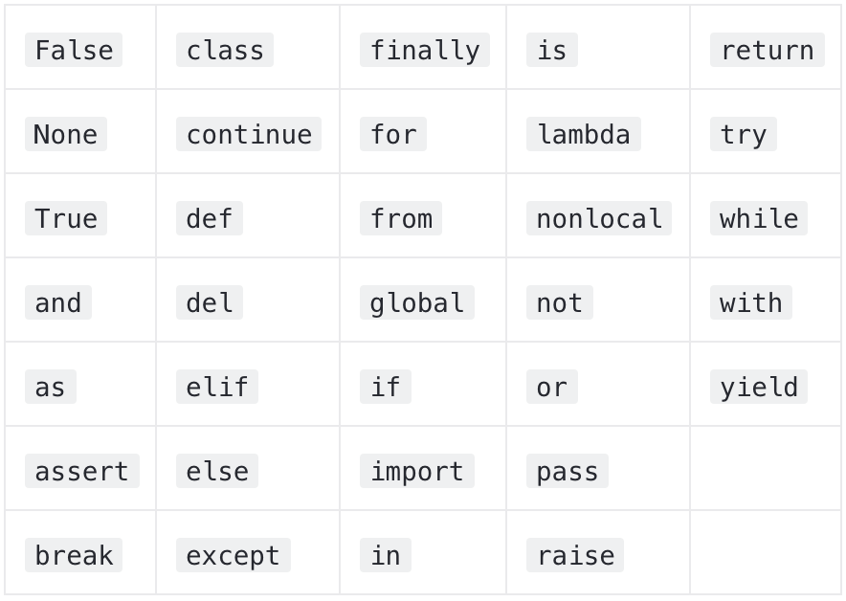
Python Keywords

Slide 3
Python Identifiers Test
first_name
while
name1
1name
AGE
_id, _
age$
3

Slide 4
Python Data Types
Integer and Long
Float / Floating Point
Complex Numbers
Boolean
None
Sequence
Sets
Mappings

Slide 5
Python Data Types Test
Write a program to save the following values of a User:
Name
Age
Year of birth
Is New User?
List of his/her favorite food

Slide 6
Input and Output
input()
print()

Slide 7
Python User input Test
Write a Program to take marks of a User in English, Science and Maths and print the average of these marks.

Slide 8
Comments in Python
Single line comments start with hash symbol (#)
Multi - line comments start and end with triple quoted strings (’’’)

Slide 9
Python Operators
Arithmetic Operators → + , - , / , * , % , // , **
Assignment Operators → += , -= , *= , /= , %= , //= , **=
Relational / Comparison Operators → ==, != , < , > , <= , >=
Logical Operators → and , not , or

Slide 10
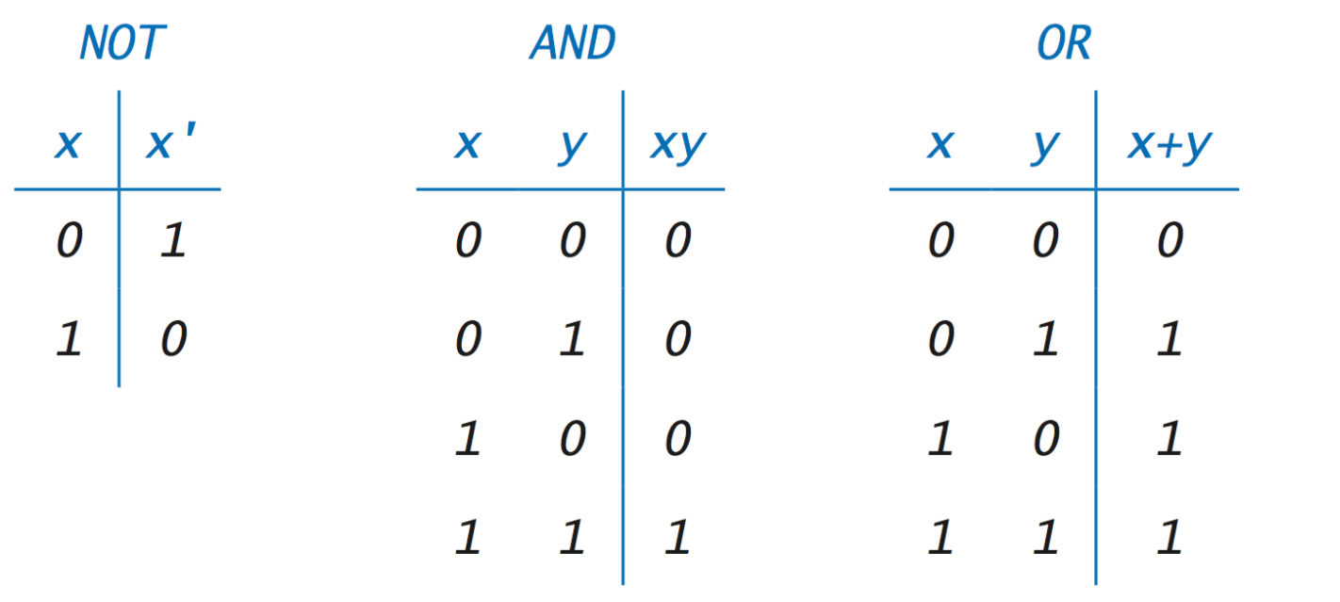
Truth Tables

Slide 11
Python Arithmetic Operators Test
Write a Program to take the average of three numbers.

Slide 12
if
if test expression:
statement(s)
In Python, the body of the if statement is indicated by the indentation. Body starts with an indentation and the first unindented line marks the end.
The body of if is executed only if test expression evaluates to True.

Slide 13
if...else
if test expression:
Body of if
else:
Body of else
The if..else statement evaluates test expression and will execute body of if only when test condition is True.
If the condition is False, body of else is executed. Indentation is used to separate the blocks.

Slide 14
if...elif...else
if test expression:
Body of if
elif test expression:
Body of elif
else:
Body of else

Slide 15
Python nested if statements
We can have a if...elif...else statement inside another if...elif...else statement. This is called nesting in computer programming.
Any number of these statements can be nested inside one another. Indentation is the only way to figure out the level of nesting. This can get confusing, so must be avoided if we can.

Slide 16
Python range() function
We can generate a sequence of numbers using range() function. range(10) will generate numbers from 0 to 9 (10 numbers). → [0, 1, 2, 3, 4, 5, 6, 7, 8, 9]
We can also define the start, stop and step size as range(start,stop,step size). step size defaults to 1 if not provided.

Slide 17
Python for loop
The for loop in Python is used to iterate over a sequence (list, tuple, string) or other iterable objects. Iterating over a sequence is called traversal.
for val in sequence:
Body of for

Slide 18
Python while loop
The while loop in Python is used to iterate over a block of code as long as the test expression (condition) is true.
We generally use this loop when we don't know beforehand, the number of times to iterate.
while test_expression:
Body of while

Slide 19
break & continue
The break statement terminates the loop containing it.
The continue statement is used to skip the rest of the code inside a loop for the current iteration only. Loop does not terminate but continues on with the next iteration.

Slide 20
Python Strings
A string is a sequence of characters
Strings can be created by enclosing characters inside a single quote or double quotes. Even triple quotes can be used in Python but generally used to represent multiline strings and docstrings.
Strings are immutable. This means that elements of a string cannot be changed once it has been assigned. We can simply re-assign different strings to the same name.

Slide 21
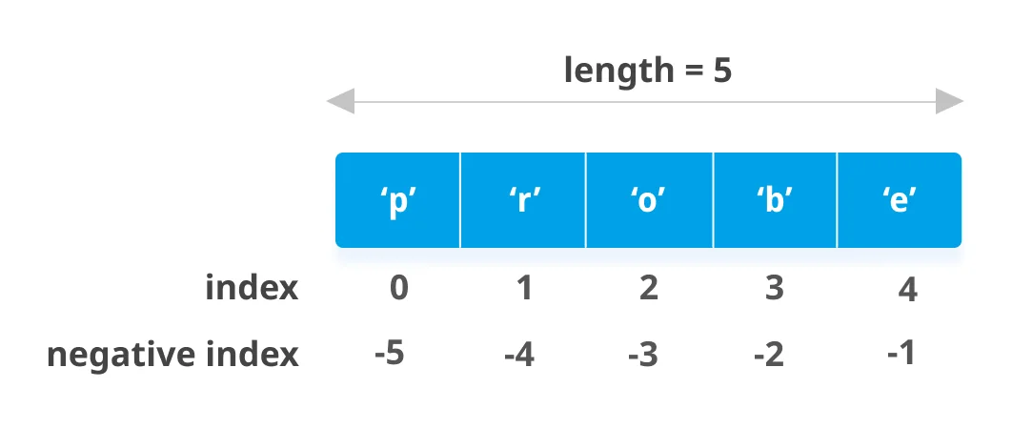
Python Strings indexing

Slide 22
Accessing characters in a String (slicing)
We can access individual characters using indexing and a range of characters using slicing. Index starts from 0. Trying to access a character out of index range will raise an IndexError. The index must be an integer.
Python allows negative indexing for its sequences.
The index of -1 refers to the last item, -2 to the second last item and so on. We can access a range of items in a string by using the slicing operator (colon).

Slide 23
Using + and * operators with Strings
Joining of two or more strings into a single one is called concatenation.
The + operator does this in Python. Simply writing two string literals together also concatenates them.
The * operator can be used to repeat the string for a given number of times.

Slide 24
for loops with Strings
for letter in 'Hello':
print(letter*2, end = “ “)
Prints:
HH ee ll ll oo

Slide 25
Python String methods
isalpha()
isdigit()
islower()
lower()
upper()
isupper()
lstrip()
rstrip()

Slide 26
Python Lists
In Python programming, a list is created by placing all the items (elements) inside a square bracket [ ], separated by commas.
It can have any number of items and they may be of different types (integer, float, string etc.).
my_list = []
my_list = [1, 2, 3]
my_list = [1, "Hello", 3.4]

Slide 27
Lists comprehension
List comprehension is an elegant and concise way to create a new list from an existing list in Python.
List comprehension consists of an expression followed by for statement inside square brackets.
new_list = [expression for item in list if condition]
pow2 = [2 ** x for x in range(10)]
# Output: [1, 2, 4, 8, 16, 32, 64, 128, 256, 512]
print(pow2)

Slide 28
Lists methods
append
insert
sort
pop
clear
reverse
index
count

Slide 29
Lists functions
len(list)
max(list)
min(list)
list(seq)
sum(list)

Slide 30
for loops with Lists
for car in [‘swift’, ‘ritz’, ‘ferrari’]:
print(car)
Prints:
swift
ritz
ferrari

Slide 31
Tuples
A tuple is created by placing all the items (elements) inside parentheses (), separated by commas. The parentheses are optional, however, it is a good practice to use them.
Tuples are immutable. This means that elements of a tuple cannot be changed once it has been assigned.
my_tuple = ()
my_tuple = (1, 2, 3)
my_tuple = (1, "Hello", 3.4)

Slide 32
Tuple operations
Accessing element from a tuple
Positive and negative indexing → like Lists
Slicing → like Lists
Iterating through a tuple → like Lists

Slide 33
Tuple functions
len(tuple)
max(tuple)
min(tuple)
tuple(seq)
sum(tuple)

Slide 34
Dictionary
Python dictionary is an unordered collection of items. While other compound data types have only value as an element, a dictionary has a key: value pair.
my_dict = {}
my_dict = {1: 'apple', 2: 'ball'}
my_dict = {'name': 'John', 1: [2, 4, 3]}
my_dict = dict({1:'apple', 2:'ball'})

Slide 35
Iterating through a Dictionary
Using a for loop we can iterate through each key in a dictionary.
squares = {1: 1, 3: 9, 5: 25, 7: 49, 9: 81}
for i in squares:
print(squares[i])

Slide 36
Updating Dictionary items
You can also update a dictionary by modifying existing key-value pair or by merging another dictionary to an existing one.
We can add new items or change the value of existing items using assignment operator.
If the key is already present, value gets updated, else a new key: value pair is added to the dictionary.
my_dict = {'name':'Jack', 'age': 26}
my_dict['age'] = 27

Slide 37
Python functions
In Python, function is a group of related statements that perform a specific task.
Functions help break our program into smaller and modular chunks. As our program grows larger and larger, functions make it more organized and manageable.

Slide 38
Categories of functions
Built-in
Modules
User-defined

Slide 39
Built-in functions
int() / float() / eval()
input()
min() / max()
abs()
type()
len()
round()
range()

Slide 40
Modules
A module is a file containing functions and variables defined in separate files. A module is simply a file that contains Python code. When we break a program into modules, each module should contain functions that perform related tasks.

Slide 41
Importing from modules
We can import the definitions inside a module to another module or the interactive interpreter in Python.
We use the import keyword to do this.
import math
We can rename modules using as
We can import specific names from a module without importing the module as a whole using from.

Slide 42
Important modules
math
random
string

Slide 43
User-defined functions
Syntax of Function
def function_name(parameters):
"""docstring"""
statement(s)

Slide 44
Calling the functions
Once we have defined a function, we can call it from another function, program or even the Python prompt. To call a function we simply type the function name with appropriate parameters.
>>> greet(‘Anuj’)
Hello, Anuj. Good morning!

Slide 45
Returning from the functions
The return statement is used to exit a function and go back to the place from where it was called.
return [expression_list]

Slide 46
Python Functions Test
Write a function which takes a list of names as argument and greets “Hello” to everyone

Slide 47
What is a file?
File is a named location on disk to store related information. It is used to permanently store data in a non-volatile memory (e.g. hard disk).
in Python, a file operation takes place in the following order.
Open a file
Read or write (perform operation)
Close the file

Slide 48
How to Open a file?
Python has a built-in function open() to open a file. This function returns a file object.
We can specify the mode while opening a file. In mode, we specify whether we want to read 'r', write 'w' or append 'a' to the file. We also specify if we want to open the file in text mode or binary mode.
We can also use with statement instead of open() and close():
with open(‘filename.txt’, ‘w’) as fileObject:

Slide 49
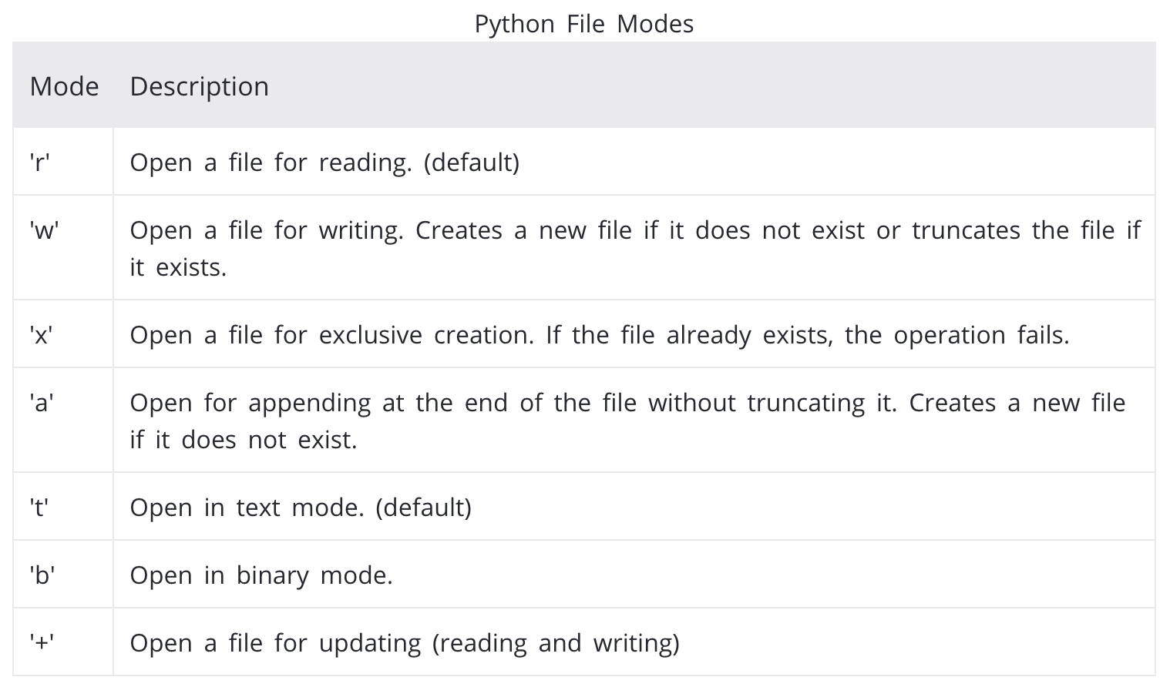
Modes while opening a file

Slide 50
Reading from a file
Open the file using ‘r’ mode. We get a fileObject that can be used to read from the file.
We can read a file line-by-line using a for loop. This is both efficient and fast.
>>> for line in f:
... print(line, end = '')
Alternately, we can use readline() method to read individual lines of a file. This method reads a file till the newline, including the newline character.

Slide 51
Writing to a file
Open the file using ‘w’ mode. We get a fileObject that can be used to write strings into the file.
fileObject.write(string)
fileObject.writelines(sequence)

